Slide 1


Powered by:
Attendees’ Portal
Sign-in instructions:
Link to the new portal: https://ucla.cloud-cme.com/default.aspx
UCLA, UCLA Health, Harbor-UCLA, and VA Employees: Please sign in with SSO Credentials.
All Other Learners: Use the "forgot your password?" feature to reset your password. Your username is your email address.
Click on the My CME button from the top menu and Registration & Receipts to view your past and future registration.

Slide 2
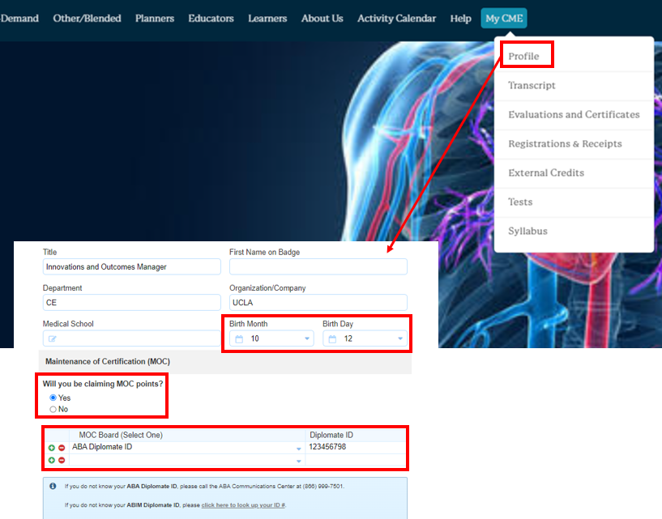
Powered by:
Profile Set-Up
Instructions:
Link to the new portal: https://ucla.cloud-cme.com/default.aspx
Click on the “My CME” button from the main menu bar and click “Profile”
Update your profile information
*If you intend to claim MOC points for the courses that are registered for MOC Part II, provide your birthdate and the board information in MOC section

Slide 3
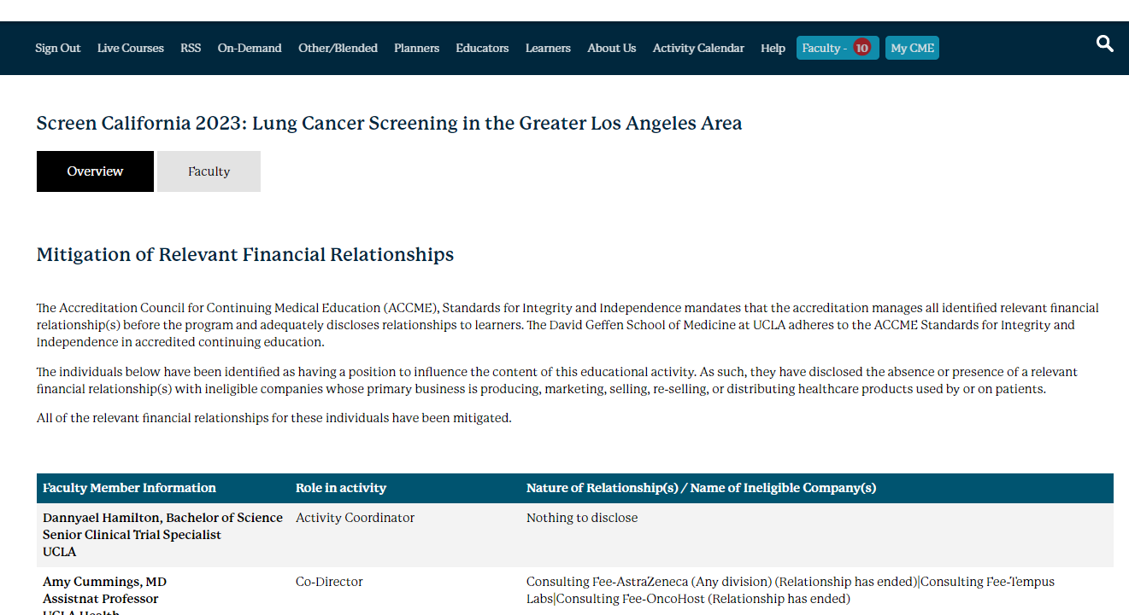
Powered by:
Continuing Education (CE) Accreditation and Disclosures
Review the accreditation information and disclosures for individuals identified as having a position to influence the content of this educational activity.
Link to the course page: Click Here
Click on the “Overview” tab to review course information including accreditation statements
Click on the “Faculty” tab under the course title to review disclosures

Slide 4
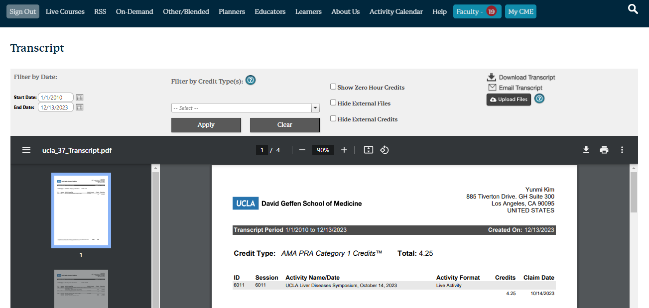
Powered by:
CE Transcript
Instructions:
Follow the link: https://ucla.cloud-cme.com/default.aspx
Click the “My CME” button from the main menu bar
Click “Transcript” button

Slide 5
Powered by:
Virtual Conference Check-In
Via Text Message:
Session Child ID: INSERT
Pair your mobile number to your account: Text your email address to (866) 875-4686.
You will receive a text notification indicating your phone number has been updated.
Send the course ID above via text to (866) 875-4686.
Please note, that texting attendance can only be recorded 60 minutes prior to the course start time, during the course, and up to 120 minutes after the course end time.
If you encounter any issues, please email ccpd@mednet.ucla.edu.

Slide 6

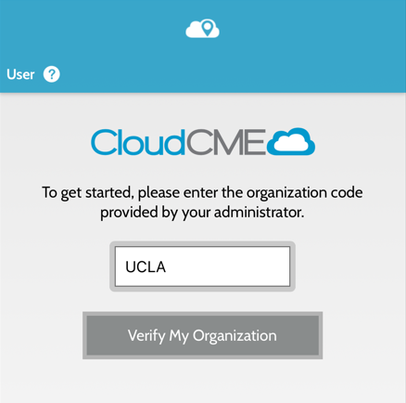
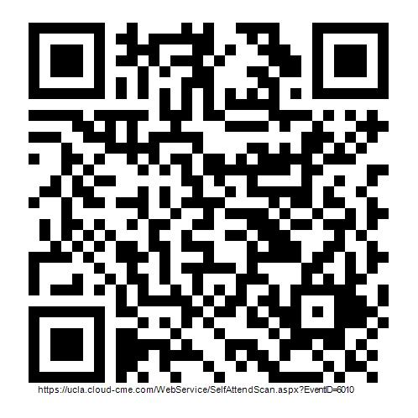
Powered by:
Virtual Conference Check-In
Via QR Code using CloudCME Mobile App:
Download the app from your mobile
Input the organization code: UCLA
Sign in using your username and password
Click “Scan Attendance”
Scan the QR code
THIS IS SAMPLE
REPLACE QR CODE
Please note, that attendance can only be recorded 60 minutes prior to the course start time, during the course, and up to 120 minutes after the course end time.
If you encounter any issues, please email ccpd@mednet.ucla.edu.

